Slide 1
The Plain-Language Project
Article 7

Slide 2
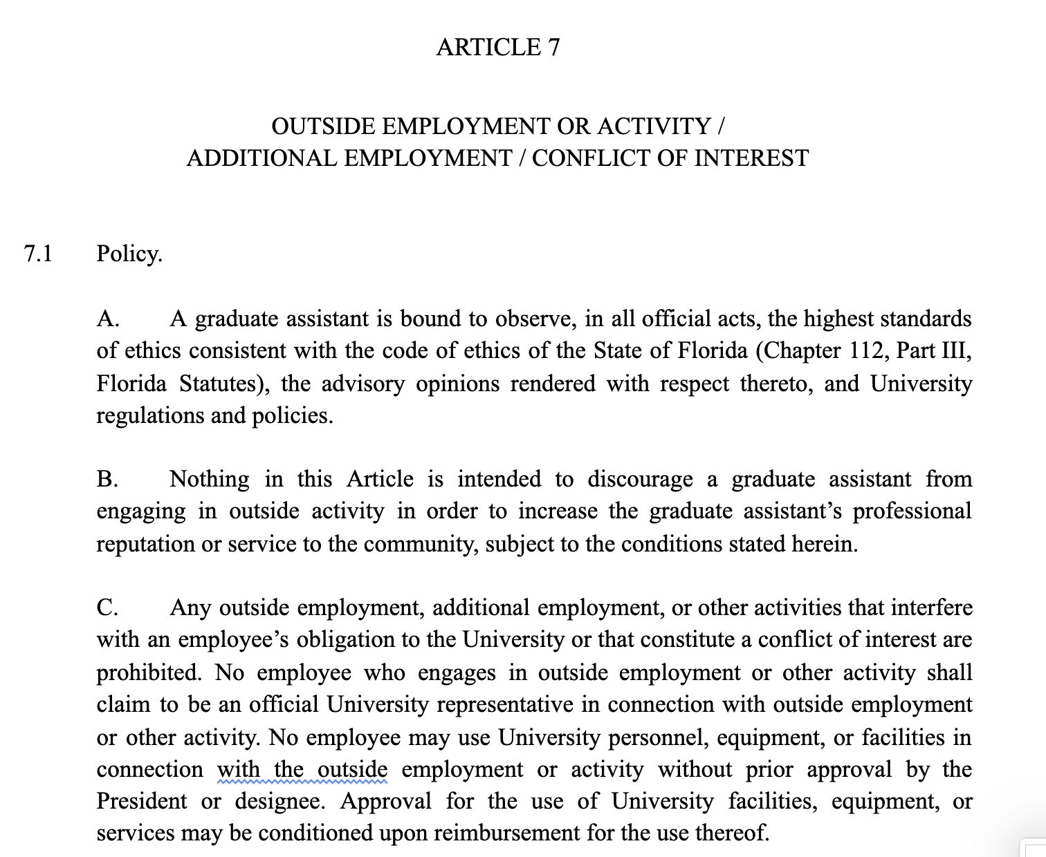

Slide 3
Article 7 Outside Employment or Activity/Additional Appointment/Conflict of Interest
This article has three parts: (1) is about the who/what/in-which-ways of your ability to hold down work outside FSU. (2) is about any other activities outside FSU which may pose conflicts of interest. And finally (3) is a conflict-of-interest section governing which relationships are appropriate with students and which aren’t.

Slide 4
7.1 Policy
Policy
This section is dedicated to explaining how these three seemingly disparate topics have in common so that they share an article. Namely, that much of this is a matter of ethics: what employment and activities you can have outside of FSU, and who you should hold authority over in your job for FSU, that sort of thing. The goal is to keep everything above-board and conflict-of-interest free. Propriety and ethics are the key words, here.

Slide 5
7.1 A
A. A graduate assistant is bound to observe, in all official acts, the highest standards of ethics consistent with the code of ethics of the State of Florida (Chapter 112, Part III, Florida Statutes), the advisory opinions rendered with respect thereto, and University regulations and policies.
Graduate assistants are obligated to be ethical, specifically according to the code of ethics of the state of Florida (see Chapter 112 Part III of the Florida Statutes for specifics), and also according to how FSU interprets that code of ethics. You also have to be ethical according to FSU’s standards, too.

Slide 6
7.1 B
B. Nothing in this Article is intended to discourage a graduate assistant from engaging in outside activity in order to increase the graduate assistant’s professional reputation or service to the community, subject to the conditions stated herein.
Don’t let this article stop you from doing stuff outside FSU, especially things that could help you professionally (think conferences, publishing, interning, &c.) or just generally be good things to do (community service type stuff). Now, of course, you gotta keep in mind all the following rules...

Slide 7
7.1 C
C. Any outside employment, additional employment, or other activities that interfere with an employee’s obligation to the University or that constitute a conflict of interest are prohibited. No employee who engages in outside employment or other activity shall claim to be an official University representative in connection with outside employment or other activity.
You cannot have a job outside FSU or any “activities” outside FSU that interfere with your obligation to do your job for FSU. Ditto any outside jobs or activities that could be conflicts of interest with your FSU job. When you ARE working or doing “activities” outside FSU, you cannot say you are an official representative of FSU.

Slide 8
7.1 C (con’t)
No employee may use University personnel, equipment, or facilities in connection with the outside employment or activity without prior approval by the President or designee. Approval for the use of University facilities, equipment, or services may be conditioned upon reimbursement for the use thereof.
You can’t use FSU equipment, buildings, or employees for your outside-FSU job or activities unless you get approval ahead of time from the FSU President or someone he designates as able to give you this approval. FSU can totally say that if you want to use FSU equipment, buildings, or employees for your outside-FSU job or activities, then you gotta pay FSU back for using them.

Slide 9
7.2 Terms
Terms
What follows is a bunch of definitions!

Slide 10
7.2 A
A. Outside employment or activity is defined as private practice, private consulting, additional teaching or research, or other professional activity, compensated or uncompensated, which is not part of an employee’s assigned University duties, conducted by the employee outside of the employee's University appointment with a non-University entity or entities.
“Outside employment or activity”: any private teaching, consulting, research, job, &c. that is not part of your FSU duties that you do for someone who isn’t FSU. This includes both paid AND unpaid work.

Slide 11
7.2 B
B. Conflict of interest is defined as any conflict between the private interests of the employee and the public interests of the University, or the State of Florida, including conflicts of interest specified under Florida Statutes, or any activity that interferes with the full performance of the employee’s obligations to the university.
“Conflict of Interest” = any conflict between your interests as a private human being and the public interests of FSU or the state of Florida generally. This includes conflicts of interest specified by Florida Statutes, or any activity that interferes with doing your job for FSU.

Slide 12
7.2 C
C. Additional employment is any employment, within the University, that serves as an additional appointment to the employee’s primary appointment in the bargaining unit, as defined in Article 1.1.
“Additional employment” = any job WITHIN FSU that is in addition to and separate from your primary appointment as a graduate assistant (so think like, picking up some hours working at the library).

Slide 13
7.2 D
D. “Relatives” are individuals related to each other in the following ways, whether by blood, adoption, marriage (in-laws/step), or other legal action: spouses, parents, grandparents, children, grandchildren, siblings, aunts/uncles, or nieces/nephews.
“Relatives” = people related to you by: blood, adoption, marriage, or other legal ways. Includes: spouses, in-laws, step-relatives, parents, grandparents, children, grandchildren, siblings, aunts, uncles, nephews, nieces.

Slide 14
7.3 Permissibility of Outside Employment or Activity and Additional Employment.
7.3 Permissibility of Outside Employment or Activity and Additional Employment.
This section will cover what you ARE allowed to do outside FSU for a job.

Slide 15
7.3 A
A. Except for those circumstances outlined in Section 7.3(B), departments shall permit outside activity or employment to the extent that such activity or employment does not constitute a conflict of interest, as defined in Section 7.2 (B).
Your department is not allowed to ban you from having a job outside FSU UNLESS it falls under "conflict of interest" from 7.2 B above or it is part of a permissible department-specific policy as described below in 7.3 B.

Slide 16
7.3 B
B. Departments or individual programs may institute a policy that restricts outside employment or activity for graduate assistants, but such policies shall not apply to graduate assistants with a total stipend less than 125% of the 0.5 FTE minimum per semester, as specified in Section 23.1 A.
Individual departments CAN have an anti-outside-job policy, but they can’t do this if your stipend is less than 125% of the .5 FTE minimum. Basically, take the minimum stipend, multiply that by 125% (1.25). If you make LESS than that in a SEMESTER, your department can’t ban you from taking on outside work. If you make more, they can.
At $15,600 minimum stipend, 125% is $19,500, or $9,750 in a semester.

Slide 17
7.3 B (con’t)
Further, departments or individual programs that employ such a policy must submit a rationale and justification for the Academic Dean and the Dean of the Graduate School for approval. A copy of the aforementioned rationale and justification shall also be submitted to UFF-FSU-GAU for the purpose of providing notification of the proposed policy. Approval shall only be granted for such requests if the department can clearly articulate a compelling reason why its interests in limiting outside employment or activity outweigh the interests of its graduate assistants to engage in outside employment or activity. If approved, the policy and its rationale must be clearly posted on the department’s website and be included in all letters of admission and appointment and sent to UFF-FSU-GAU.
In order to institute one of these policies banning their graduate assistants from outside work, your department would have to submit a reason why to the Academic Dean and Dean of the Graduate School and get their approval. Your department would then have to submit all this to US at the GAU to tell us it’s happening. Departments only get approved to do this if there’s a good reason to ban their graduate assistants from working outside FSU, and those reasons have to outweigh the benefits to graduate assistants of having the outside work opportunities.
If approved, departments have to post that they have this policy and the reason why on their website, AND include it in letters of admission/appointment.

Slide 18
7.3 C
C. Additional employment shall be permitted to the extent that such activity or employment does not constitute a conflict of interest, as defined in Section 7.2 (B), and fully complies with the workload limitations as specified in Article 6.1 (A).
Having an additional job within FSU that’s not your main GA appointment is totally allowed as long as it’s not a conflict of interest according to 7.2 B, and as long as you’re complying your workload limitations according to 6.1A.

Slide 19
7.4 Report of Outside Employment or Activity and Additional Employment
7.4 Report of Outside Employment or Activity and Additional Employment.
This section deals with how and when you need to formally put on record outside employment.

Slide 20
7.4 A
If you’re going to engage in compensated OR uncompensated outside activities or employments, which you think could be a conflict of interest, you need to give your supervisor a letter that says what that activity/job is going to be BEFORE you do it. Your department chair or someone similar will evaluate it and decide if you’re good within 14 days of you giving them that letter. You can totally do the job/activity during those 14 days while you’re waiting, as long as you don’t think the answer from your supervisor is going to be “no.”
A. A graduate assistant who proposes to engage in any uncompensated outside activity which the graduate assistant should reasonably conclude may create a conflict of interest, or in any outside compensated employment or activity, shall report to the graduate assistant’s supervisor(s), in writing, the details of such proposed activity prior to engaging therein. The department chair or appropriate department administrator shall assess whether such activity or employment constitutes a conflict of interest and respond to the employee, in writing, within fourteen (14) days of receipt of the proposal. This shall not preclude the employee from engaging in the employment or activity while waiting for a response, unless the employee reasonably concludes that a conflict of interest exists.

Slide 21
7.4 B
B. The report shall include, where applicable, the name of the employer or other recipient of services; the funding source; the location where such activity shall be performed; the days and hours involved; and the nature and extent of the activity.
When you write this letter to your supervisor, you should include: name of employer/whoever you’re doing things for, the funding source (if there is one), the location you’ll be working/doing activities, the days and hours involved, and the nature and extent of the activity.

Slide 22
7.4 C
Instead of going through the whole process of filing a grievance, a graduate assistant who gets told they can’t do outside employment/activity because it’s a “conflict of interest” can ask for the written opinion of the GAU president or representative. Have to do this within 5 days of getting the decision from their department.
Alternatively, within 10 days of getting the decision from their department, a graduate assistant can get a review in writing from the “University Review Committee on Outside Activities and Conflict of Interest” to review the decision. They could also convene a subcommittee of that committee that includes at least 3 members of the original committee, that’ll count, too.
C. As an alternative to the expedited grievance process outlined in Article 11.15, in the event the proposed outside activity, outside employment, or additional employment is determined to constitute a conflict of interest, the employee may seek the written opinion of the UFF-FSU-GAU President or designee, within five (5) days. Within ten days (10) of the original decision, the employee may seek a review in writing by the University Review Committee on Outside Activities and Conflict of Interest, or a subcommittee of at least three members thereof, for an advisory opinion, unless the Committee has been consulted previously on this matter.

Slide 23
7.4 C (con’t)
The written opinion of the UFF-FSU-GAU President or designee shall be considered by the Committee. The Committee shall render its opinion in writing within seven (7) days of receipt of the graduate assistant’s request. If the Committee concludes that the outside activity should have been approved, it shall consult with the approving authority to seek resolution on the matter. Should satisfactory resolution not be attained, the Committee may recommend to the Dean of the Graduate School that the activity be approved. The employee may continue the outside or additional employment in question, until such time as the Dean of the Graduate School deems that the employment is not permissible.
That committee will consider not just the decision of the department, but also the written opinion of the GAU President/Representative. The committee has to give you a decision within 7 days of you submitting your request to them. If they think that you should be allowed to work/do activities outside your department, they will talk with your department and straighten them out. If your department still pushes back, they’ll get the Dean of the Graduate School involved to personally approve your job/activity. While all this is going on, you can keep doing your outside job/activity, until a final decision comes down from the Dean of the Graduate School that you can’t.

Slide 24
7.5 Relationships with students
7.5 Relationships with students. Sexual relationships between graduate assistants and students where a direct supervisory or evaluative relationship exists are fraught with the potential for exploitation. The respect and trust accorded a graduate assistant by a student, as well as the power exercised by the graduate assistant in a direct supervisory or evaluative role, make voluntary consent by the student suspect. In their relationships with students under their direct supervision, graduate assistants are expected to be aware of their professional responsibilities and to avoid conflict of interest, favoritism, or bias.
This section is about relationships with students. A sexual relationship between student and graduate assistant who is in charge of them in some way--includes supervising, evaluation, &c.--is ripe for exploitation. It’s difficult to imagine how consent can be possible between a student and a graduate assistant who holds a position of power over them. Therefore, the burden is on the graduate assistant to keep in mind their position of power over their students and not abuse it. Graduate assistants should not show bias or favoritism to particular students and avoid conflicts of interest.

Slide 25
7.5 A
A. When any direct supervisory or evaluative role exists, a consensual sexual relationship between a student and a graduate assistant is a conflict of interest.
If a graduate assistant is in charge of a student, if there is a sexual relationship between them that is, by definition, a conflict of interest.

Slide 26
7.5 B
B. Any situation of direct supervision or evaluation will be ended immediately when a consensual sexual relationship between a student and a graduate assistant exists.
If you are in a sexual relationship with a student that you are in charge of--either because you’re supervising them or evaluating them--you have to end the role you have over them.

Slide 27
7.5 C
C. Any such relationship must be disclosed to the graduate assistant’s supervisor immediately.
If you’re in a sexual relationship with a student you have to disclose it to your supervisor immediately.

Slide 28
7.5 D
D. Direct supervision includes any type of evaluative role.
“Direct supervision” = any type of evaluative role. So if you’re a grader, teaching assistant, course instructor, lab group leader, &c. over a student.

Slide 29
7.6 Other relationships with students
7.6 Other relationships with students. Graduate Assistants may not serve in a direct teaching or supervisory role for students who are relatives, as defined in this Article. In rare cases, and only when no other viable option exists, an exception may be requested in writing for review and approval by the Graduate School and the Provost, who may add conditions to mitigate the possibility of bias.
Graduate assistants cannot be supervisors or teachers of students who are relatives (as defined in 7.1D). If there’s no options, and people can’t get moved around, you can request an exception in writing to the Graduate School and the provost. They might add some conditions to your employment to try and eliminate the possibility of bias.

