Slide 1
The Plain-Language Project
Article 8

Slide 2
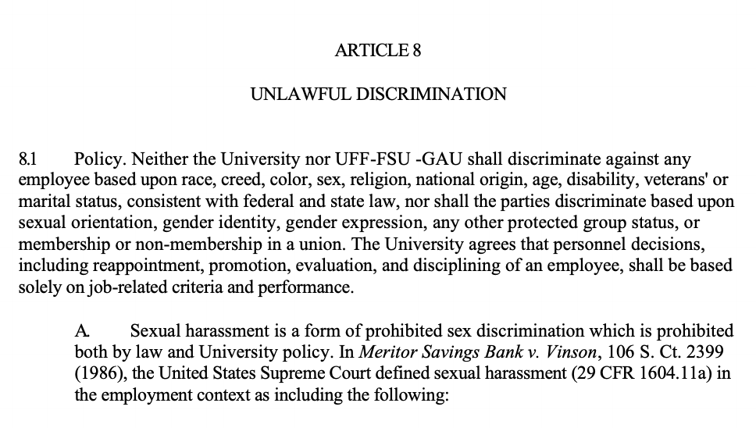

Slide 3
Article 8 Unlawful Discrimination
This is the article that deals with discrimination based on race, creed, color, sex, religion, national origin, age, disability, veterans' or marital status.
FSU isn’t allowed to discriminate against you for any of those reasons.

Slide 4
8.1 Policy
Both FSU and GAU cannot discriminate against anyone based on race, creed, color, sex, religion, national original, age, disability, veterans’ or marital status.
They also can’t discriminate based on sexual orientation, gender identity, gender expression, any protected group status, OR if you’re in a union or not.
Personnel decisions in specific have to be SOLELY based on job stuff, not ANY of the above.
Personnel decisions include stuff like: continuing to employ you, promoting you, evaluating you, or disciplining you
8.1 Policy. Neither the University nor UFF-FSU -GAU shall discriminate against any employee based upon race, creed, color, sex, religion, national origin, age, disability, veterans' or marital status, consistent with federal and state law, nor shall the parties discriminate based upon sexual orientation, gender identity, gender expression, any other protected group status, or membership or non-membership in a union. The University agrees that personnel decisions, including reappointment, promotion, evaluation, and disciplining of an employee, shall be based solely on job-related criteria and performance.

Slide 5
8.1 A
A. Sexual harassment is a form of prohibited sex discrimination which is prohibited both by law and University policy. In Meritor Savings Bank v. Vinson, 106 S. Ct. 2399 (1986), the United States Supreme Court defined sexual harassment (29 CFR 1604.11a) in the employment context as including the following:
Sexual harassment (in an employment context) = a specific type of sex discrimination that is not allowed.
It’s both illegal AND against University policy.
What follows is a definition of sexual harassment from a Supreme Court case in 1986:

Slide 6
8.1A (con’t) Supreme Court Quote
Sexual harassment IS:
When someone you don’t want to is asking you to have sex, do sex stuff for them, or generally touching/talking sex stuff at you, AND:
They’re implying or telling you outright that you going along with any of the above is just a part of working there;
They decide if they’re going to hire or keep you on based on whether or not you go along with any of the above, OR;
Them doing any of the above interferes with your work or makes your workplace suck hard.
Unwelcome sexual advances, requests for sexual favors, and other verbal or physical conduct of a sexual nature constitute sexual harassment when (1) submission to such conduct is made either explicitly or implicitly a term or condition of an individual's employment, (2) submission to or rejection of such conduct by an individual is used as the basis for employment decisions affecting such individual, or (3) such conduct has the purpose or effect of unreasonably interfering with an individual's work performance or creating an intimidating, hostile, or offensive working environment.

Slide 7
8.1 B
FSU doesn’t want discrimination and harassment all over the place, so it wants you to report this stuff ASAP.
If you’re a supervisor you’re required to report an allegation of discrimination/harassment from the people you supervisor to the “appropriate administrators.”
Ditto for course instructors re: allegations from students.
“Appropriate administrators” = your supervisor, graduate coordinator, department chair, your dean, EOC admin, or HR.
B. To promote an environment at the University which is free from unlawful discrimination and harassment, graduate assistants are encouraged to report immediately any concerns regarding discrimination or sexual harassment. Graduate assistants acting in a supervisory capacity (including supervisors of laboratories) or teaching capacity are required to report allegations from their students or those they supervise regarding discrimination, including sexual harassment, to appropriate administrators. Appropriate administrators include, but are not limited to, the employee's immediate supervisor, graduate coordinator, department chair, or Dean, or administrators in the University's Office of Equal Opportunity and Complaince (EOC) or Human Resources Department.

Slide 8
8.1 C
C. Claims of discrimination, including sexual harassment, must be processed with the University EOC office rather than through the Article 11 grievance process. Employees who file a complaint with EOC will be notified of their right to file a complaint with outside agencies. More information may be located at the EOC website.
You do NOT file a grievance for discrimination or sexual harassment.
You go through University EOC.
EOC: Equal Opportunity and Compliance.
If you file a complaint with EOC, they’ll tell you that you have a right to file a complaint outside the University, too.
Go to the FSU EOC website to learn more!

