Slide 1
The Plain-Language Project
Article 10

Slide 2
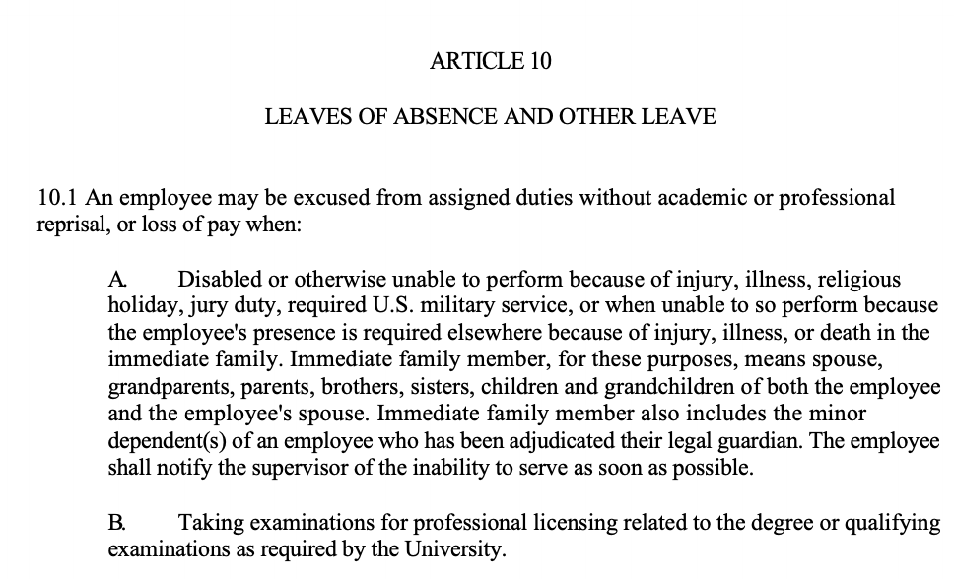

Slide 3
Article 10 Leaves of Absence and Other Leave
This will be the article that deals with when you can be out of work!

Slide 4
10.1
An employee may be excused from assigned duties without academic or professional reprisal, or loss of pay when:
They’re about to list 5 specific times when you’re allowed to miss work WITHOUT getting in trouble or missing out on any pay. Note that this is missing stuff for your role as an EMPLOYEE, NOT for missing stuff (like classes) in your role as a STUDENT. But the good news is, you cannot be penalized as EITHER an employee OR a student for missing WORK related activities for the following reasons:

Slide 5
10.1 A
If you are disabled/injured, sick, observing a religious holiday, have jury duty, called to US military service (like if you’re in the reserves).
If someone in your immediate family is injured, ill, or dies and you need to be not at work.
“Immediate family” = spouse, grandparents, parents, siblings, children, grandchildren of yourself or your spouse; also minor children that you’re the legal guardian of.
Notify your supervisor that you’ll be out ASAP.
A. Disabled or otherwise unable to perform because of injury, illness, religious holiday, jury duty, required U.S. military service, or when unable to so perform because the employee's presence is required elsewhere because of injury, illness, or death in the immediate family. Immediate family member, for these purposes, means spouse, grandparents, parents, brothers, sisters, children and grandchildren of both the employee and the employee's spouse. Immediate family member also includes the minor dependent(s) of an employee who has been adjudicated their legal guardian. The employee shall notify the supervisor of the inability to serve as soon as possible.

Slide 6
10.1 B
B. Taking examinations for professional licensing related to the degree or qualifying examinations as required by the University.
When you’re taking tests to get professional licenses RELEVANT to your degree, or;
When you’re taking exams for your degree that your department/University requires.

Slide 7
10.1 C
C. Traveling to conferences or other events for professional development. FSU-BOT and the UFF-FSU-GAU encourage supervisors to facilitate professional development and approval of attendance at such events shall not be unreasonably denied.
When you’re traveling to conferences &c. for your job and growth in your career. In fact, FSU and GAU WANT your supervisors to support you in traveling to conferences, both by helping make it happen and letting you go if it’s at all possible.

Slide 8
10.1 D
D. The University is closed, unless special conditions of the appointment require the employee to perform duties at these times.
If the University is closed, unless you’ve got some special assignment (like lab rats that need to be fed).

Slide 9
10.1 E
E. The University may request verification from a physician for an illness lasting longer than three (3) days.
If you’re sick for more than 3 days, FSU CAN ask for a doctor’s note (though FSU does not have to! Only if they want to).

Slide 10
10.2 Leave
Leave:
Now this section is going to deal with extended, unpaid time away from work, and list all the reasons that are acceptable.

Slide 11
10.2 A
A. Graduate assistants shall be entitled to up to eight (8) weeks of continuous unpaid leave during any 12-month period for any of the following reasons:
In a subcategory here, what follows are 5 specific reasons you can have up to 8 weeks in a row unpaid time off work, per year (does not have to be calendar year, just any 12 month period).

Slide 12
10.2 A (1)
(1) the birth of a child and in order to care for that child within six (6) months of birth;
From the moment your child is born to 6 months of age, you can take 8 continuous weeks off at any point during that period. (You do not have to be the one to give birth! It just has to be your child.)

Slide 13
10.2 A (2)
(2) the placement of a child with a graduate assistant for adoption or foster care and to care for the newly placed child within six (6) months of placement;
If you get a foster kid or adopt a kid, you can take 8 weeks off at any point from the moment you get the kid to 6 months later.

Slide 14
10.2 A (3)
(3) the care of a spouse, parent, or child who has a serious health condition;
If you need to take care of a sick spouse, parent, or child.

Slide 15
10.2 A (4)
(4) for a qualifying exigency arising out of the fact that a spouse, parent, or child has been called to active duty; or
If your spouse, parent, or child gets called up to active duty and this means you gotta deal with some stuff.

Slide 16
10.2 A (5)
(5) a serious health condition of the employee, which renders the employee unable to perform the essential functions of the employee's job.
If you get so sick you can’t do the main parts of your job for an extended amount of time.

Slide 17
10.2 B
B. The graduate assistant shall provide the university written notice not less than thirty (30) days prior to the date of requested leave, if practicable. In the case of an emergency, the graduate assistant must provide verbal notice within twenty-four (24) hours of taking leave, if practicable. In the case of a serious health condition, the University may request verification from a physician for an illness lasting longer than three (3) days. The University may also require the employee to see a medical provider of the University's choice and at the University's expense.
If you can, you should provide FSU in writing that you’ll be out, 30 days prior to being out.
If it’s an emergency, tell FSU within 24 hours of being out, if you can.
If you’re out because you’re sick for more than 3 days, FSU may (but doesn’t have to!) ask for a doctor’s note.
FSU can make you go see a doctor THEY pick (but FSU has to pay for it).

Slide 18
10.2 C
C. The graduate assistant is entitled to return to the same or similar position at the conclusion of the leave, provided that the graduate assistant's employment contract has not expired.
Once you’re done with your leave, you get to come back to the same or a similar job, as long as your contract hasn’t expired.

Slide 19
10.2 D
D. Upon conclusion of the leave, the graduate assistant shall not be required to make up the scheduled work hours missed as a result of taking leave.
When you’re done with the leave, you are NOT required to make up the work hours that you missed while you were away!

Slide 20
10.2 E
E. The University shall continue the payment of the tuition waiver and health insurance subsidy in accordance with Article 12 and Article 16 of this agreement, respectively, while the graduate assistant is on leave.
Even though this is called unpaid leave, FSU will keep paying a) your tuition waiver, and b) your health insurance subsidy, while you’re out. So don’t worry about those things (they have to note this because those two things are technically “compensation” things, so if you’re on “unpaid” leave it’s an open question if they’d still “pay” your tuition waiver, &c. But they will!).

Slide 21
10.2 E (con’t)
E. If the University implements a domestic partner benefits policy, the University agrees that the care of a domestic partner will be included in the leave outlined in this article.
If FSU decides to recognize domestic partners as immediate family status, then they’d fall under the reasons for leave in the same way spouse would.
FSU has not yet recognized domestic partners but this would automatically cover it if they did.

