Slide 1
The Plain-Language Project
Article 12

Slide 2
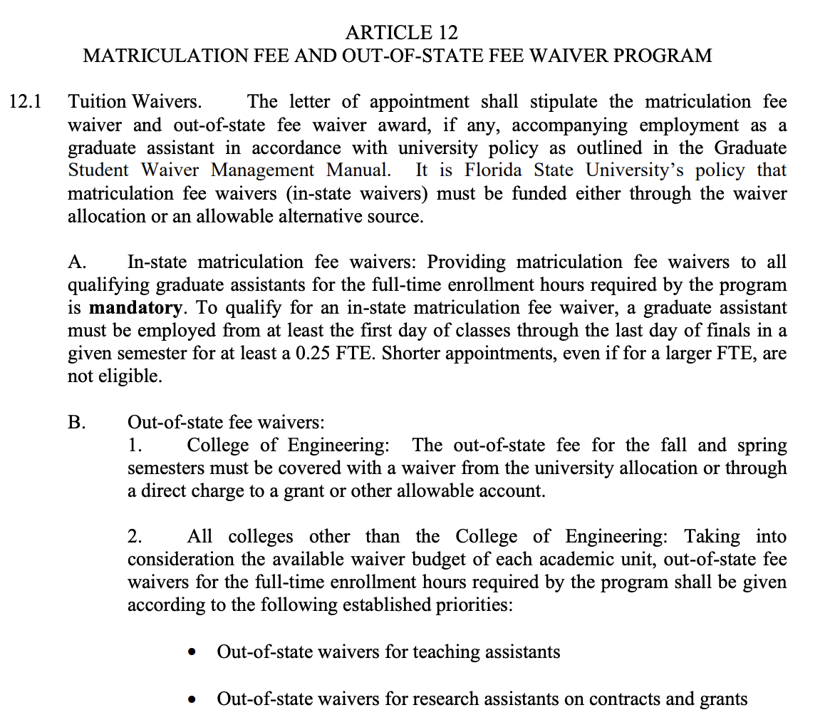

Slide 3
Article 12 Matriculation Fee and Out-of-State Fee Waiver Program
This is about matriculation fees and out-of-state fee waivers. What this does is governs who gets fees paid for and who doesn’t, and how that money gets distributed, and in what order.
A “matriculation fee” is just another word for “tuition.”
“Out-of-state” fees are extra tuition levied against any graduate assistant who doesn’t have Florida residency.
NB: While most graduate assistants become Florida residents after their first year, international graduate assistants can NEVER gain residency as they are not US citizens. Therefore they will ALWAYS be charged this out-of-state fee for the duration of their time at FSU.
NB: Outside of tuition and out-of-state tuition, no other fee waivers are mentioned in this article--while some departments may cover them there is no current contractual guarantee for all graduate assistants.

Slide 4
12.1 Tuition Waivers
The letter of appointment shall stipulate the matriculation fee waiver and out-of-state fee waiver award, if any, accompanying employment as a graduate assistant in accordance with university policy as outlined in the Graduate Student Waiver Management Manual. It is Florida State University’s policy that matriculation fee waivers (in-state waivers) must be funded either through the waiver allocation or an allowable alternative source.
When you get your letter of appointment, saying how much time you’re hired for and what your salary is going to be, this letter will also include how much a) matriculation fee waiver and b) out-of-state fee waiver, you’re getting. FSU lets your departments fund your tuition either through their tuition budgets or through other allowable sources (this would include stuff like grants).

Slide 5
12.1 A In-State Matriculation Fee Waivers
This section is about tuition waivers for the IN-state tuition rates. Tuition for students who are NOT Florida residents (“out-of-state”) is much higher than students who ARE Florida residents (“in-state”). All graduate assistants who “qualify” MUST receive tuition waivers that cover the full IN-STATE cost of their required class hours as defined by their academic program.
“Qualify” = graduate assistant starts getting employed from at least the first day of classes through the last day of finals in a given semester for at least 0.25FTE (10 hours a week).
If you are employed for a SHORTER time than this, you’re not eligible for the tuition waiver regardless of your FTE.
In-state matriculation fee waivers: Providing matriculation fee waivers to all qualifying graduate assistants for the full-time enrollment hours required by the program is mandatory. To qualify for an in-state matriculation fee waiver, a graduate assistant must be employed from at least the first day of classes through the last day of finals in a given semester for at least a 0.25 FTE. Shorter appointments, even if for a larger FTE, are not eligible.

Slide 6
12.1 B Out of State Fee Waivers
Out of State Fee Waivers
This section has to do with the out-of-state higher tuition rates that any non-Florida resident graduate assistant has to pay.

Slide 7
12.1 B (1)
1. College of Engineering: The out-of-state fee for the fall and spring semesters must be covered with a waiver from the university allocation or through a direct charge to a grant or other allowable account.
Any graduate assistant in the college of engineering who receives an out of state tuition waiver must have it paid for either by the department’s budget or through a grant or similar source.

Slide 8
12.1 B (2)
All colleges other than the College of Engineering: Taking into consideration the available waiver budget of each academic unit, out-of-state fee waivers for the full-time enrollment hours required by the program shall be given according to the following established priorities:
If an academic unit [usually a department, though this could be the library system or something like that] has any waiver money available after providing in-state waivers to all qualifying GAs, it can give out-of-state waivers to GAs who need them, prioritizing the following groups:

Slide 9
12.1 B (2) (con’t)
• Out-of-state waivers for teaching assistants
• Out-of-state waivers for research assistants on contracts and grants
• Out-of-state waivers for international graduate assistants
• Out-of-state waivers for graduate assistants not appointed as teaching assistants or as research assistants on contracts and grants
Out-of-state tuition waivers for teaching assistants;
Out-of-state tuition waivers for research assistants on contracts and grants (aka, who are being funded externally, not by FSU);
Out-of-state tuition waivers for international graduate assistants;
Out-of-state tuition waivers for graduate assistants who don’t meet any of the above categories (AKA, everyone else);

Slide 10
12.1 C
Out-of-state and matriculation fee waivers are reserved for full-time degree seeking graduate assistants.
Both out-of-state tuition waivers and in-state tuition waivers are only for full-time degree-seeking graduate assistants.

Slide 11
12.1 D
Waivers will be canceled if the student withdraws from the University, drops below the required academic load, or terminates the assistantship. Waivers will not cover any dropped classes. The student will be responsible for any fees assessed.
FSU can drop your tuition waiver if you withdraw from FSU, drop below the required class credit hours to be considered “full time,” or quit the job part of being a graduate assistant. Tuition waivers do not cover dropped classes. You have to pay fees for late-dropped classes.

Slide 12
12.1 E
E. All students receiving funding from the University will be held to the stipulations put forward by the Council of Graduate School’s resolution regarding accepting awards.
All students who get funding from FSU (like these tuition waivers) have to follow the text of a resolution on accepting awards put out by the Council of Graduate Schools. This basically means that incoming GAs who have been offered funding can’t withdraw their acceptance of that offer after April 15th without notifying the university that they’re doing so.

Slide 13
12.1 F
F. The University and UFF-FSU-GAU mutually agree to reopen this article for negotiations for the 2020-2021 year. Reopening this article will not count as one of the additional articles to be reopened as specified in Section 21.1 A of this Agreement.
In 2019, in order to end negotiations, FSU administration added a section to this article that said they would reopen this article for us in the 2020-2021 bargaining session. Since we are limited in how many articles we open every year based on Article 21.1 A, this could be helpful by letting us open up other articles while still bargaining on this one.

