Slide 1
The Plain-Language Project
Article 9

Slide 2
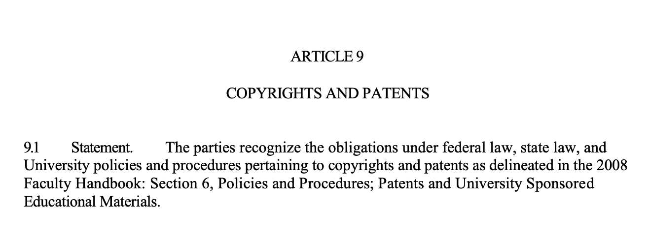

Slide 3
Article 9 Copyrights and Patents
Copyrights and Patents
Refers to work/materials/&c. produced by us when we’re working for FSU.

Slide 4
9.1 Statement
9.1 Statement. The parties recognize the obligations under federal law, state law, and University policies and procedures pertaining to copyrights and patents as delineated in the 2008 Faculty Handbook: Section 6, Policies and Procedures; Patents and University Sponsored Educational Materials.
Refer to “2008 Faculty Handbook: Section 6.”

Slide 6
2008 FSU Faculty Handbook
This policy is actually incredibly comprehensive, but it’s also 10 pages long and this is not the time or place to go into that.
If you want to check it out just look up “2008 FSU Faculty Handbook.”
Relevant pages are 122-132.
Link can be found here.

